Slide 1
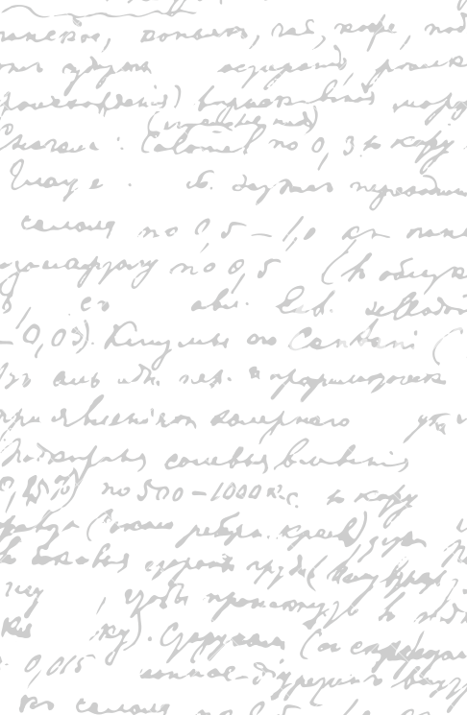

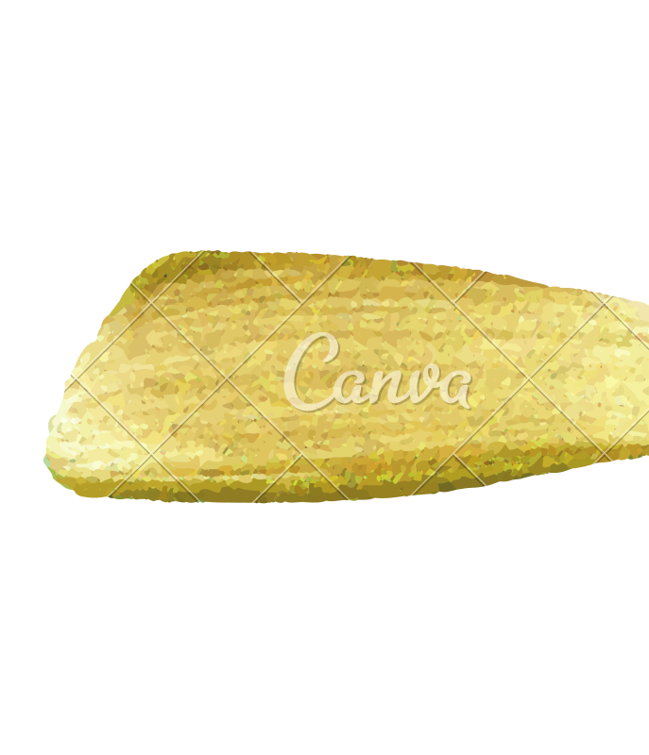

Ming Wu (Andrew) 2133861w
Laser Mate!
Project Supervisor Meeting 15
5 March 2021

Slide 2
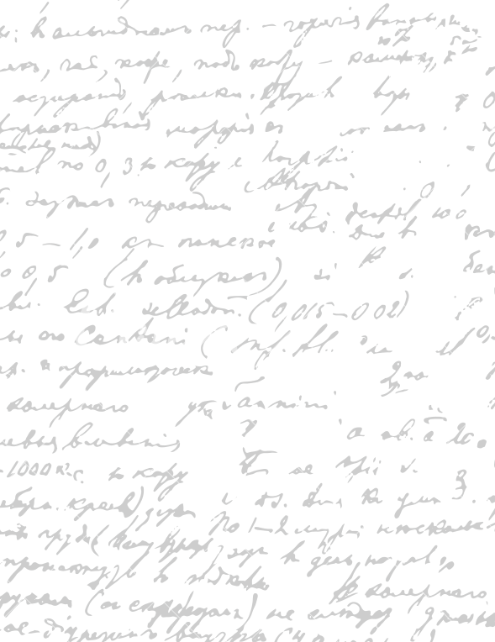



Start Recording

Slide 3
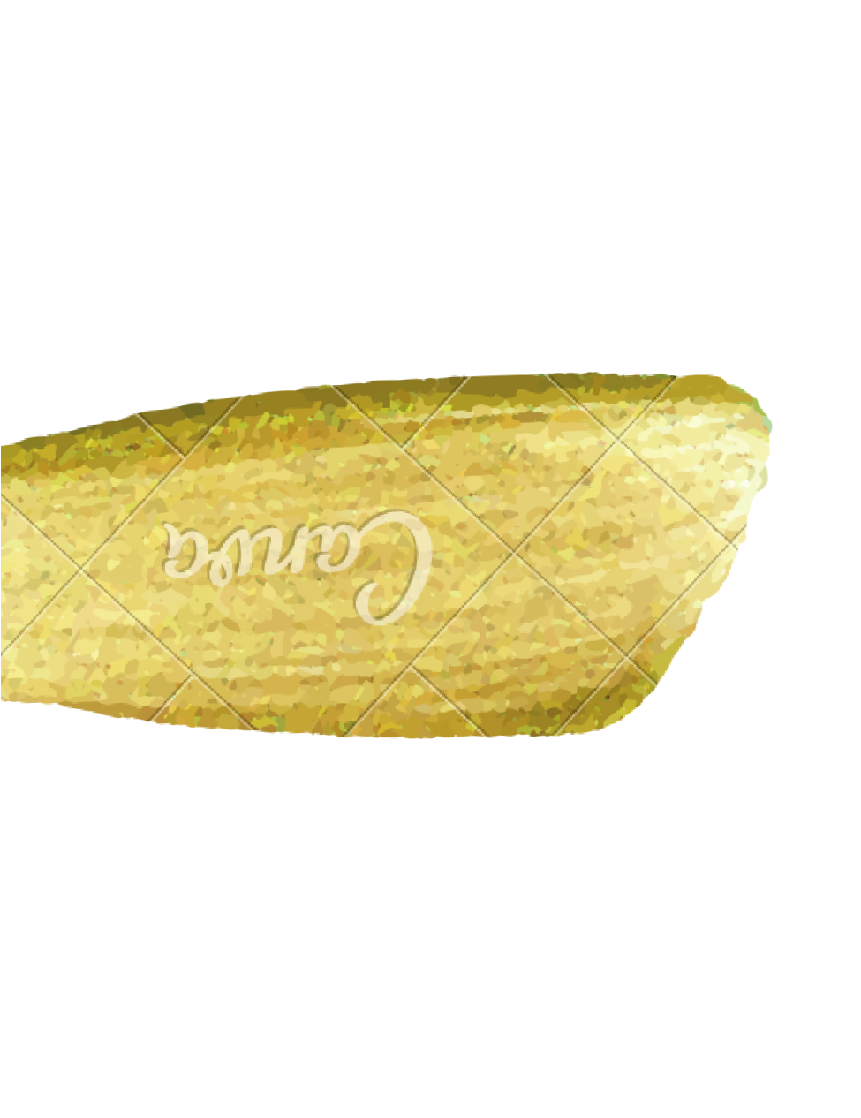
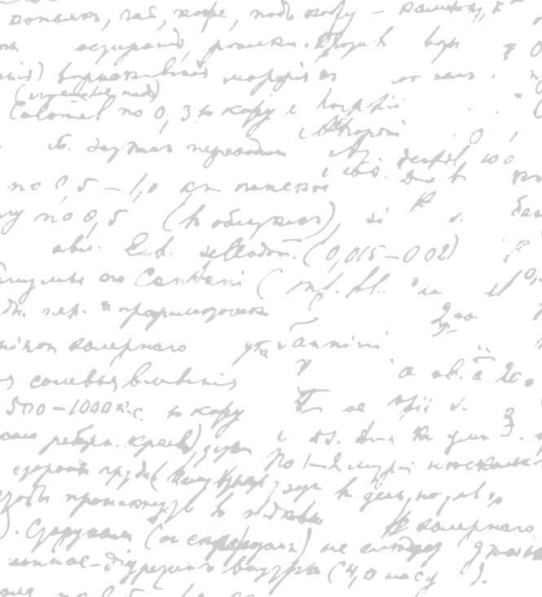

Evaluation – Google form for 1) native-speaker, 2) non-native speaker (Done)
Final Software Product
Database organization
Paper prototype
Design principles
Proofreading dissertation

Slide 4
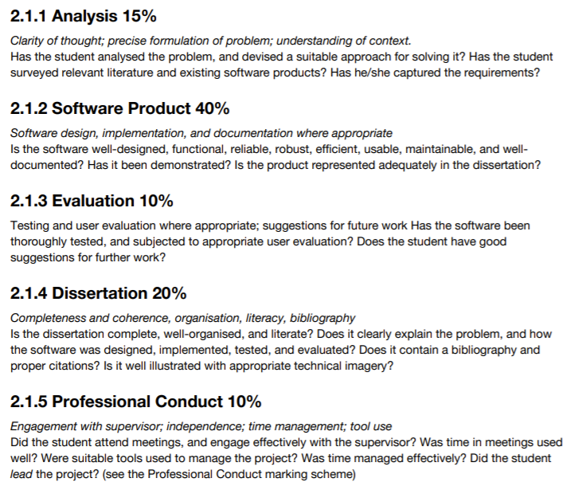
Next Step
Software Coding
Implementation (Justification of Tech Stack)
Testing Documentation
Talk about the software not the business
Software skills that you learnt
Shorten the business parts
What is difficult in the coding
Show off complexity what you built
What is interesting about your implementation
Send professor dissertation
Unimportant webpages in appendix

Slide 5
Software Coding
Implementation
Testing Documentation
Next Step

Slide 6
End

